Slide 1
Milestone 3
Steven Booth, Peter Harlan, Daniel Monterrosas, Michelle Schapmire, and Zachary Wathen

Slide 2
Introduction
Updated Project Overview and Goal/Scope
Updated Project Requirements
Hardware Software Architecture Details
Group’s Organizational Approach
Progress Visibility
System Boundaries
Security
Software System Performance

Slide 3
Updated Project Overview and Goal/Scope
Project Overview
Create a smaller Version of Wikipedia centered around WKU
Our Client
Mahn Do
Target Users
WKU Students, Faculty, Staff, Alumni
Possible future students interested in WKU
Current Sprint Objective
System Performance and Security

Slide 4
Updated Requirements
Functional
Account Creation*
Login*
Search*
Create Page
Edit Page
Recover Backup Pages
Nonfunctional
Security*
Usability*
Compatibility*

Slide 5
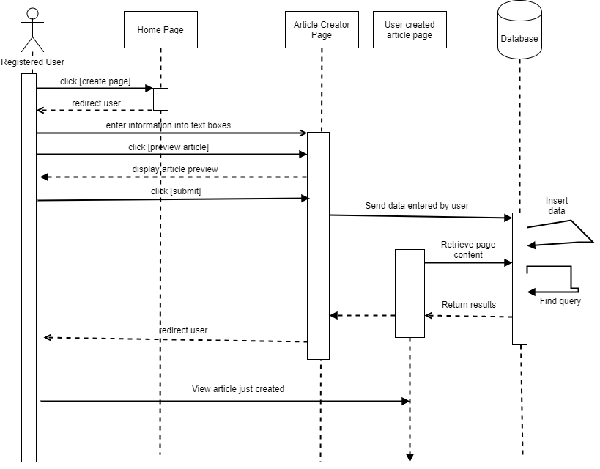
Create Page

Slide 6
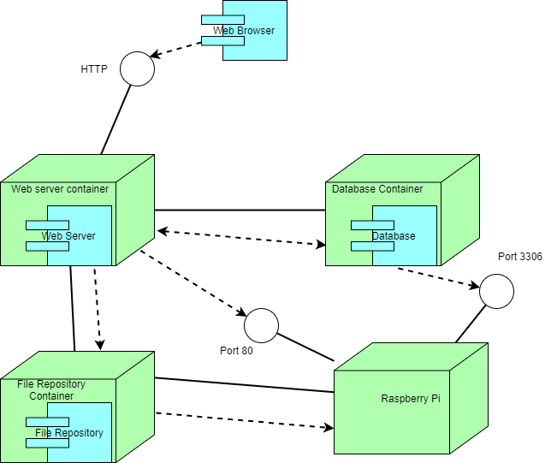
Software Architecture Details

Slide 7
Group's Organizational Approach
Meeting Time | Meeting Type | Group A | Group B
Monday 6-8:30pm | In Person/Virtual | Yes | No
Tuesday 4-7:00pm | In Person | Yes | Yes
Wednesday 7-9:30pm | In Person/Virtual | No | Yes
Thursday 7-9:00pm | Virtual | Yes | Yes
Friday 11:30-12:25pm | In Person Client Meeting | Yes | Yes

Slide 8
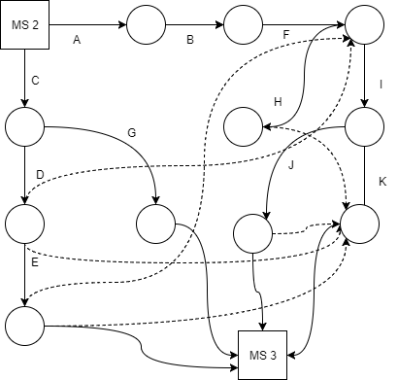
Schedule Organization

Slide 9
Schedule Organization

Slide 10
Progress Visibility
Task Name | Start Date | End Date | Duration (Days) | Days Complete | Days Remaining | Percent Complete
Get database container set up | 10/9 | 10/16 | 7 | 7.00 | 0.00 | 100%
Create Page function design | 10/9 | 10/16 | 7 | 7.00 | 0.00 | 100%
Edit Page function design | 10/9 | 10/16 | 7 | 3.50 | 3.50 | 50%
Implement Create Page | 10/16 | 10/23 | 7 | 7.00 | 0.00 | 100%
Implement Edit Page | 10/27 | 10/30 | 3 | 3.00 | 0.00 | 100%
Article Display Page design | 10/16 | 10/23 | 7 | 7.00 | 0.00 | 100%
Implement Article DIsplay Page | 10/27 | 10/30 | 3 | 3.00 | 0.00 | 100%
Define software performance requirements | 10/20 | 10/22 | 2 | 2.00 | 0.00 | 100%
Define security requirements | 10/20 | 10/22 | 2 | 2.00 | 0.00 | 100%
Create security models | 10/22 | 10/24 | 2 | 2.00 | 0.00 | 100%
Run performance tests | 10/22 | 10/29 | 7 | 7.00 | 0.00 | 100%
Create milestone 3 report draft | 10/20 | 10/27 | 7 | 7.00 | 0.00 | 100%
Create admin page | 10/27 | 10/31 | 4 | 4.00 | 0.00 | 100%
Create final milestone 3 report | 10/29 | 11/3 | 5 | 5.00 | 0.00 | 100%
Create presentation for client | 10/31 | 11/3 | 3 | 3.00 | 0.00 | 100%
Deliver report and presentation to client | 11/3 | 11/4 | 1 | 1.00 | 0.00 | 100%

Slide 11
Software Process Model
Iterative/Incremental Development Process

Slide 12
Risk Management
Prevalent risks/ problems in this Milestone
SD card corrupted
Pi password resets
Time Management

Slide 13
System Boundaries
Physical Boundaries
Pi RAM of 1 GB
Unreliable internet for server
Pi becomes hot after constant use
Logical Boundaries
3 Docker Containers
PHP IDE

Slide 14
Security Issues
Security Requirements
Identification – identifies user during login
Authentication – identified based on email and password
Authorization – Three types of users
Integrity – Keep files backed-up
Threats
SQL injections
Buffer Overflows

Slide 15
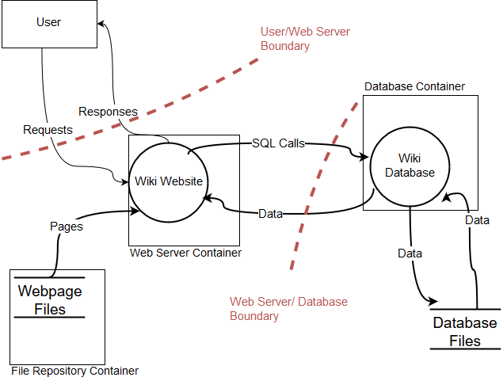
Security Threat Model

Slide 16
Software System Performance
Component | Performance Objective
Database | Handle 200 transactions per second
File I/O | Process 5,000 kb/sec
CPU | Execute 10,000 events under 300 seconds
Network | Ping under 100ms
Subsystem Type | Hardware | Performance Expectations
CPU | 4x ARM Cortex-A53 | Minimum speed 700MHz
 |  | Maximum speed 1.2GHz
 |  | L1 Cache 8-64KiB
 |  | L2 Cache 128KiB-2MiB
Network | BCM43438 wireless "combo" chip | Dual-band 2.4 GHz and 5 GHz IEEE 802
File I/O | 1GB LPDDR2 | Internal Access Rate 200MHz
 |  | I/O Bus Clock Frequency 400MHz
 |  | Data Transfer Rate 800MT/s

Slide 19
Average Execution Rate (Kb/s) File I/O

Slide 20
Average Total Time CPU 15K Prime

Slide 21
Task Label | Description | Personnel | Required Resources | Task Dependency | Hours Est.
A | Link database container to webserver | Michelle | Docker, PutTy |  | 3
B | Define performance/security requirements | Michelle, Steven, Daniel |  |  | 2
C | Design Create/Edit Page function | Zach, Peter, Steven |  |  | 3
D | Implement Create Page | Zach, Daniel, Peter | Apache, Mysql, PHP, Bootstrap | C | 10
E | Implement Edit Page | Zach, Peter | Apache, Mysql, PHP, Bootstrap | D | 6
F | Run performance tests | Michelle | Docker, Mysql, Raspbian | D, E | 5
G | Design Article Page | Peter | Bootstrap |  | 3
H | Create Admin Page | Peter, Zach, Daniel |  |  | 6
I | Create milestone 3 draft | Everyone |  | B, F | 8
J | Create final report | Everyone |  | I | 6
K | Create presentation for client | Everyone |  | J, D, E, H | 4

Slide 22
Database Transactions 1M Table

